Slide 1
Visual Embedding and Visual Search
Liangliang Cao
https://columbia6894.github.io/

Slide 2
Why Visual Search Is Important?
Applications demanded by the increasing amount of images/videos:
Diving into personal albums
Recommending Youtube/news/TV shows
Searching clothes and fashion products
Organizing social media
Visual search goes beyond the limits of visual classification:
Unlimited amount of categories
Easily integrated with other systems.
Bear in mind that searching is complicated… we will discuss one example built from scratch.

Slide 3
Outline
Visual search based on local descriptors (SIFT)
Visual search based on deep embedding
FaceNet
Pinterest Visual Search

Slide 4

Visual search based on local descriptors
Key reference:
Most of the slides in this subsection are courtesy to David Nistér and Henrik Stewénius

Slide 5

Visual search based on local descriptors
Notes:
I will now try to describe the approach with an animation.
The first, offline phase, is to train the vocabulary tree.
We use Maximally Stable Extremal Regions by Matas et al. and then we extract SIFT descriptors from the MSER regions.
Regarding the feature extraction, we are not really claiming anything other than down-in-the-trenches nose-to-the-grindstone hard work to get good implementations of the state-of-the-art, and since we are all obsessed with novelty I will not spend any time talking about the feature extraction.
We believe that the vocabulary tree approach will work well on any of your favorite descriptors.

Slide 6

Visual search based on local descriptors
Notes:
All the descriptor vectors are thrown into a common space.
This is done for many images, the goal being to acquire enough statistics on how natural images distribute points in the descriptor space.

Slide 7
Visual search based on local descriptors

Slide 8
Notes:
We then run k-means on the descriptor space. In this setting, k defines what we call the branch-factor of the tree, which indicates how fast the tree branches.
In this illustration, k is three. We then run k-means again, recursively on each of the resulting quantization cells.
This defines the vocabulary tree, which is essentially a hierarchical set of cluster centers and their corresponding Voronoi regions.
We typically use a branch-factor of 10 and six levels, resulting in a million leaf nodes. We lovingly call this the Mega-Voc.

Slide 9
Visual search based on local descriptors

Slide 10
Visual search based on local descriptors

Slide 11
Visual search based on local descriptors

Slide 12
Visual search based on local descriptors

Slide 13
Visual search based on local descriptors

Slide 14
Visual search based on local descriptors

Slide 15
Visual search based on local descriptors

Slide 16
Visual search based on local descriptors

Slide 17
Visual search based on local descriptors

Slide 18
Notes:
We now have the vocabulary tree, and the online phase can begin.
In order to add an image to the database, we perform feature extraction. Each descriptor vector is now dropped down from the root of the tree and quantized very efficiently into a path down the tree, encoded by a single integer.
Each node in the vocabulary tree has an associated inverted file index.
Indecies back to the new image are then added to the relevant inverted files.
This is a very efficient operation that is carried out whenever we want to add an image.

Slide 19


Slide 20


Slide 21


Slide 22


Slide 23
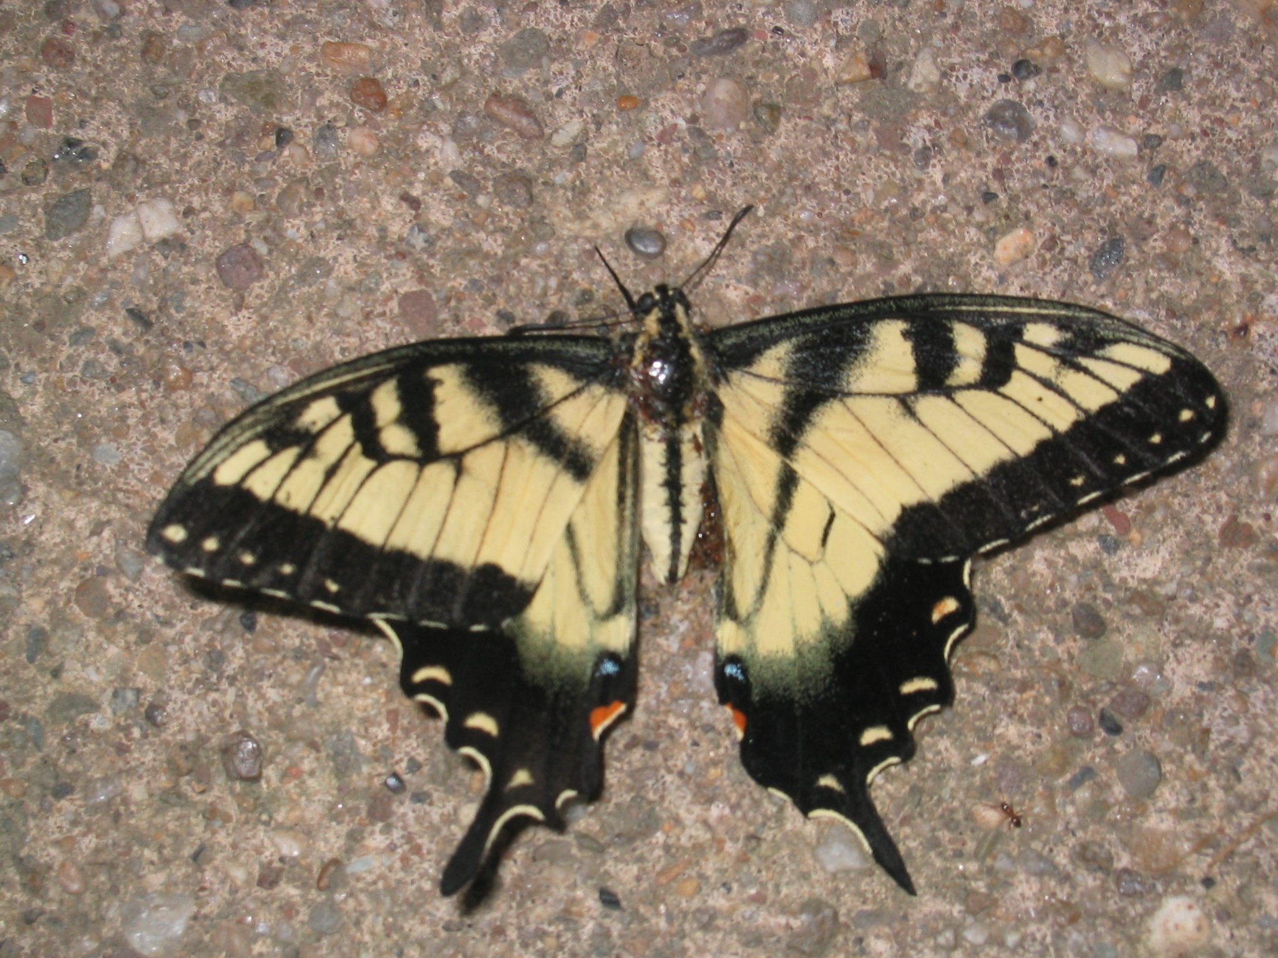
Notes:
When we then wish to query on an input image, we quantize the descriptor vectors of the input image in a similar way, and accumulate scores for the images in the database with so called term frequency inverse document frequency (tf-idf). This is effectively an entropy weighting of the information. The winner is the image in the database with the most common information with the input image.

Slide 24
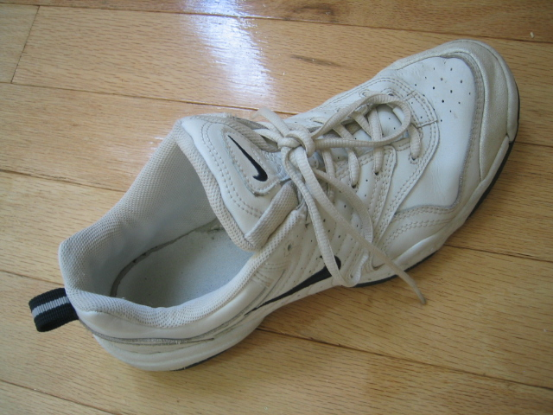
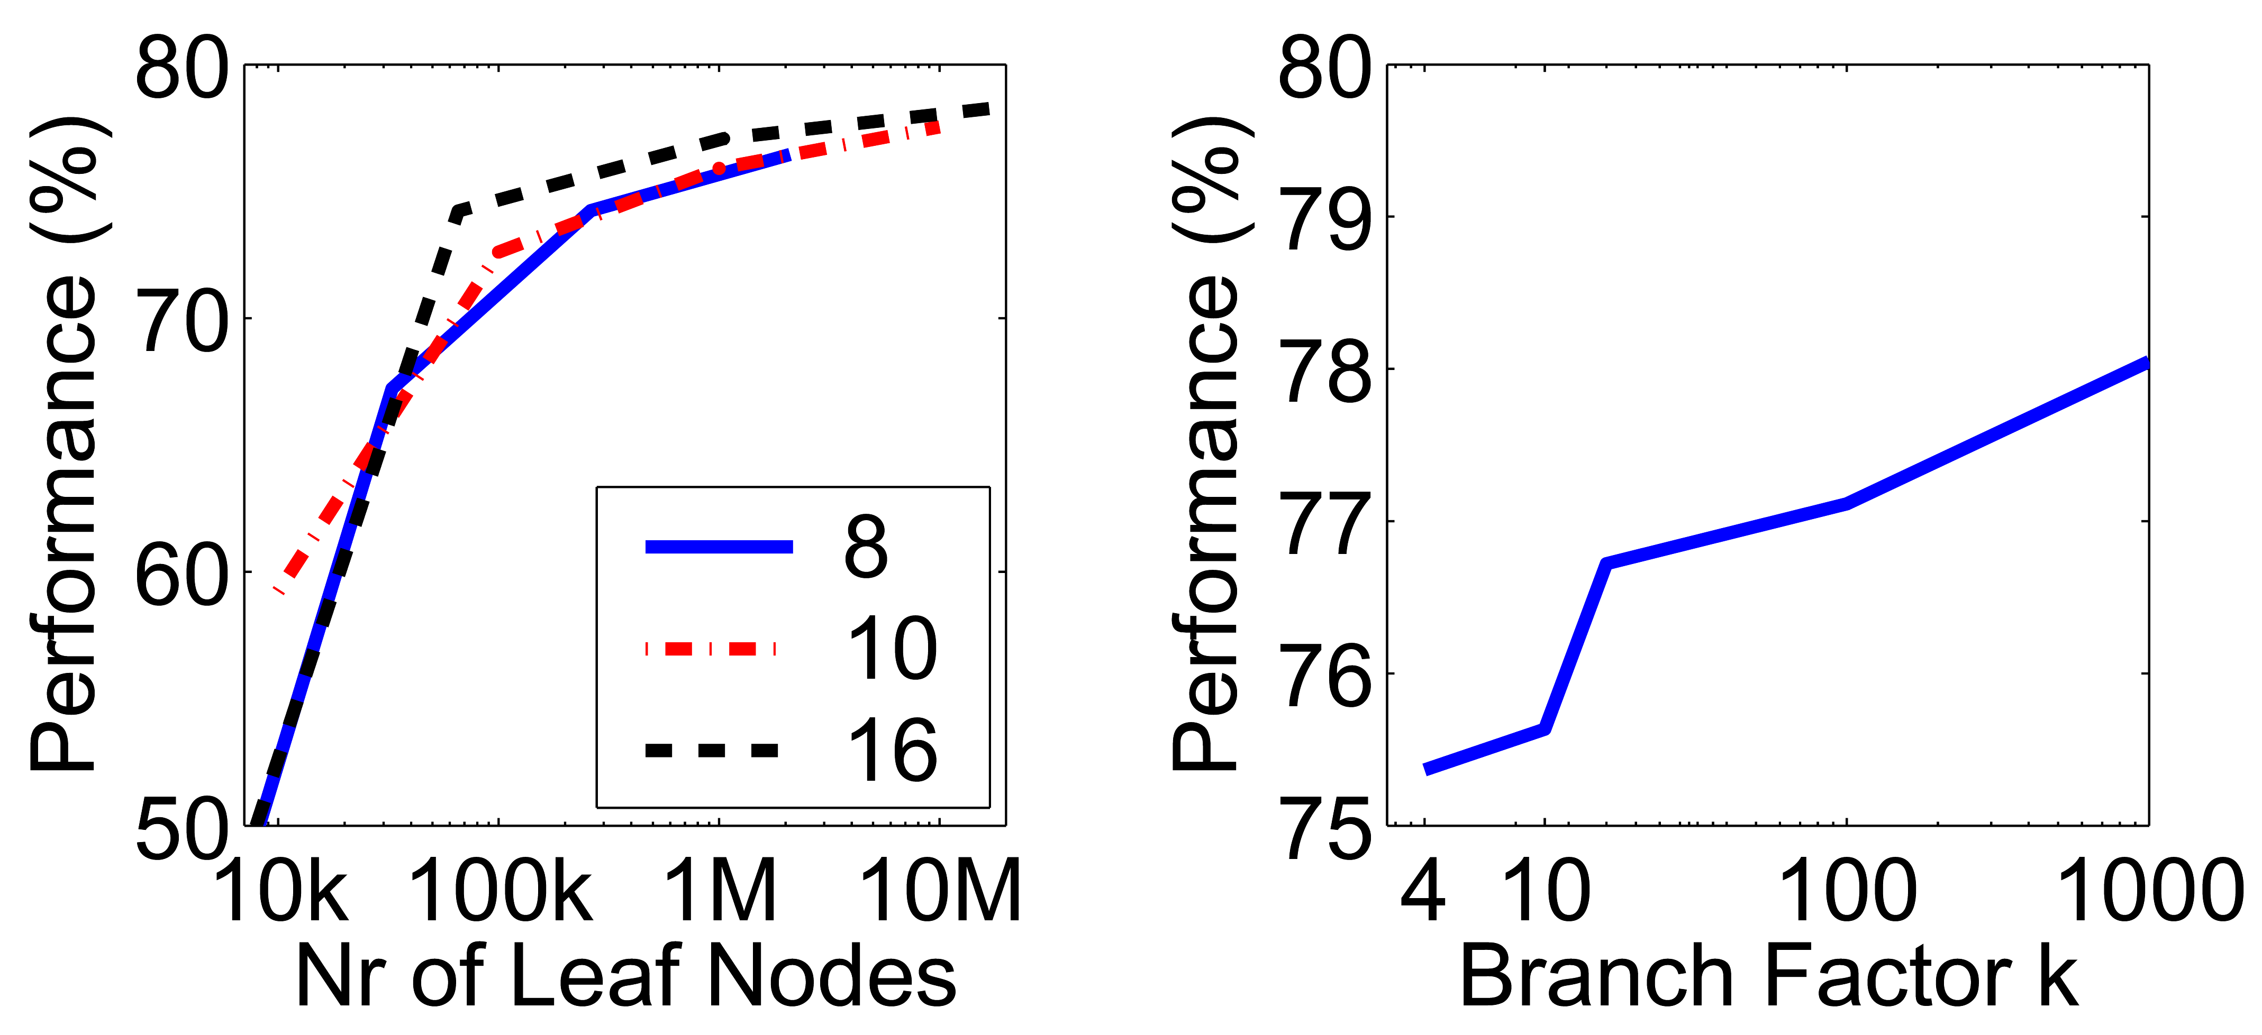


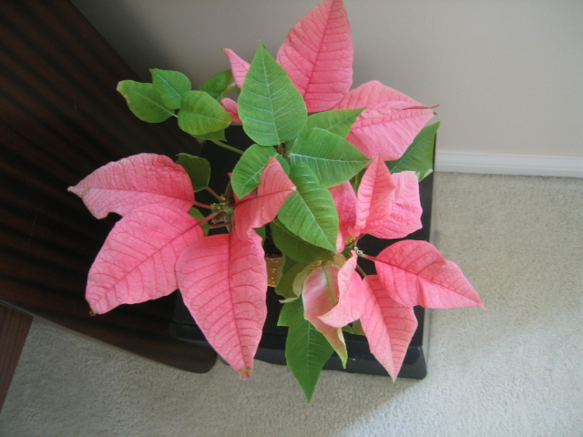




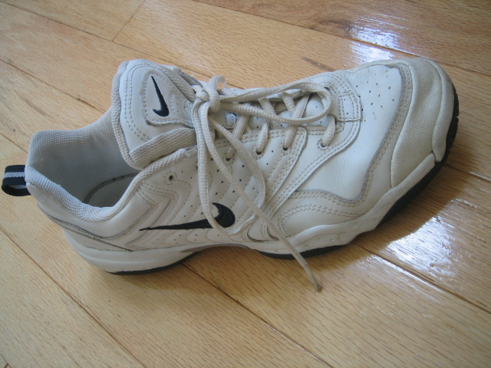
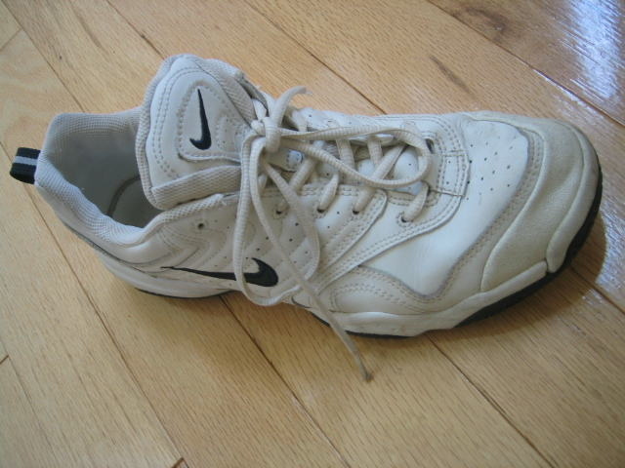
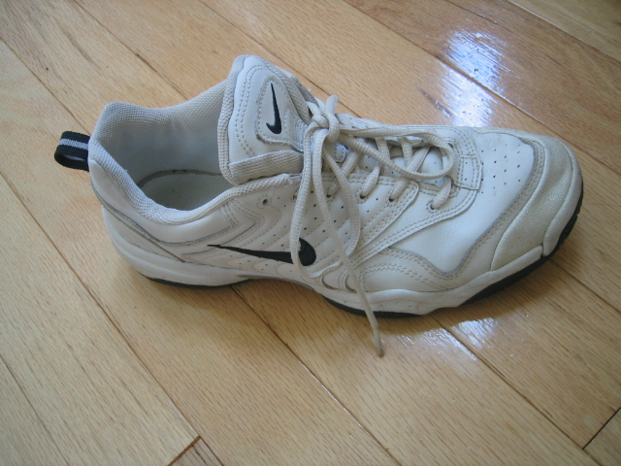










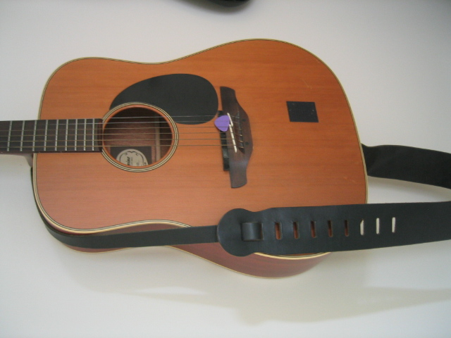
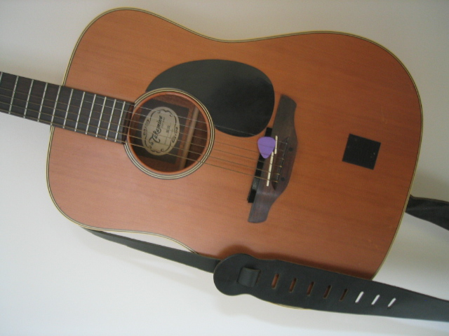
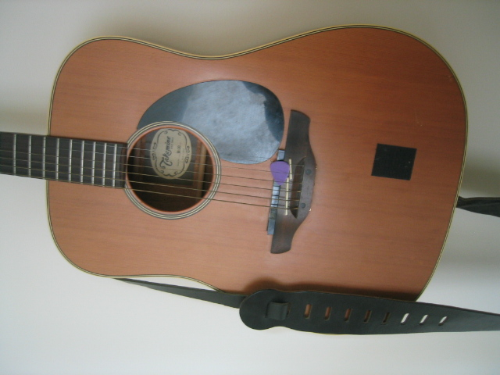
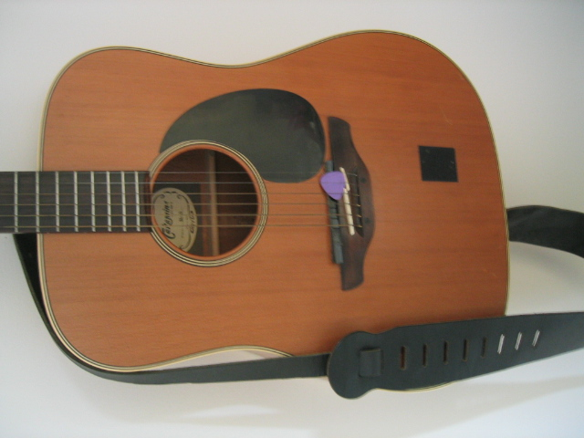
Search Results
Further Improvement
Learning better rank functions
Add spatial verification
Notes:
One of the reasons we managed to take the system this far is that we have worked with rigorous performance testing against a database with ground truth.
We now have a benchmark database with over 10000 images grouped in sets of four images of the same object. We query on one of the images in the group and see how many of the other images in the group make it to the top of the query.
In the paper, we have tested this up to a million images, by embedding the ground truth database into a database encompassing all the frames of 10 feature length movies.

Slide 25
Lessons
Search using local descriptors is good at finding EXACT objects, but not SIMILAR ones.
No end to end learning
No semantic similarities
But we have seen the power of
Hierarchical tress
Inverted index
We shall use more powerful feature representation than local descriptors

Slide 26
Visual Search based on Deep Embedding
We want to show you the basic steps to build a visual search systems from scratch by reviewing two papers:
FaceNet
Visual Search at Pinterest

Slide 27
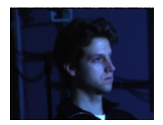

Face Embedding
Idea:
Map images to a compact Euclidean space, where distances correspond to face similarity
FaceNet: A Unified Embedding for Face Recognition and Clustering by F. Schroff et al, CVPR’15

Slide 28
Face Embedding
Learn embedding:
Learned from triple loss (by origin FaceNet paper, harder to tune)
Or learned from classification tasks (simpler in practice)
Experiment:
Detect 100M-200M faces of 8M identities
Learn embedding of 128d vectors
A simple nearest neighbor search gets 98.87% on LFW face dataset
Key takeaways
We can train neural embedding for visual search!

Slide 29
Face Embedding
Learn embedding:
Learned from triple loss (by origin FaceNet paper, harder to tune)
Or learned from classification tasks (simpler in practice)
Experiment:
Detect 100M-200M faces of 8M identities
Learn embedding of 128d vectors
A simple nearest neighbor search gets 98.87% on LFW face dataset
Key takeaways
We can train neural embedding for visual search!
What if we do not have so many samples?

Slide 30
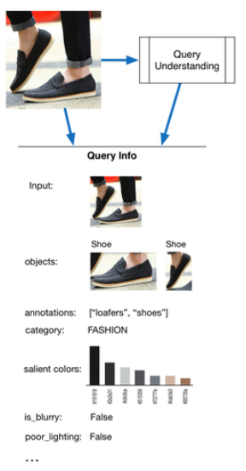
Extend Face Search to General Image Search
Represent an image with multiple clues
Embedding of the whole image
Embedding of detected regions*
Annotations, categories, etc.
* Detection will be discussed during the guest lecture on Nov 27.
Visual Search at Pinterest, by Y. Jing et al, KDD’15

Slide 31
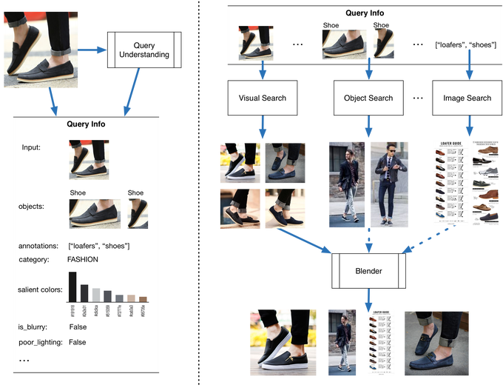
Pinterest Image Search
Visual Search at Pinterest, by Y. Jing et al, KDD’15

Slide 32
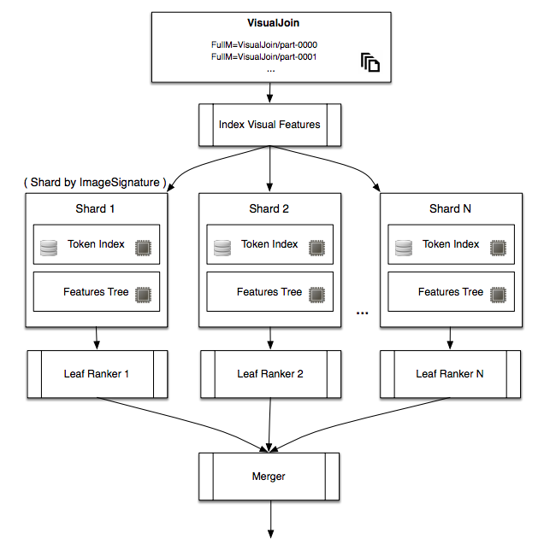
Search via Distributed Computing
Visual Search at Pinterest, by Y. Jing et al, KDD’15

Slide 33
Lessons from Pinterest Visual Search
Image Search Systems are complicated
ImageNet models give pretty good baselines for visual embedding
Integrate visual embedding with the text search
Continuously testing and measuring success, and improving the search results

